Slide 1
You’ve Got Mail Monarch 1.2 Has Arrived

Slide 2

Presenter
Greg Stilson
Head of Global Technology Innovation

Slide 3

Presenter
Jason Martin
Technical Innovations Product Manager

Slide 4
Agenda
Recap
Monarch 1.2
SDK advancements
The Exciting Wing-It app!

Slide 5
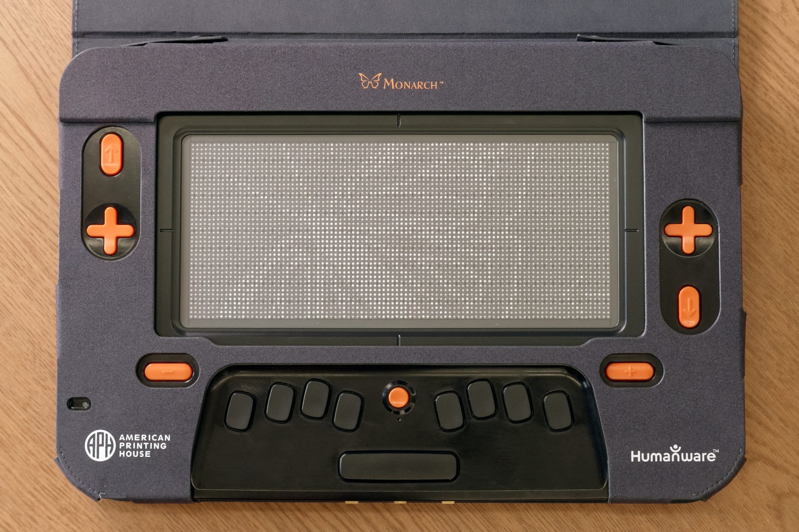
The Monarch

Slide 6
Recap
Monarch officially launched to the public 9/17/2024
Over 160 teachers were trained prior to the public launch
Foundation software provided powerful apps for a student’s day while enabling us to build for the future
Nearly 600 Monarchs in the field
Notes:
Reduce cost of braille textbook production
Greatly reduce time to child’s fingertips with digital delivery
Today an Algebra 2 book took nearly 13 months to produce and cost over $28K, with nearly 40 volumes of braille
Need for impromptu learning tools as much of mainstream education material is moving away from textbooks and toward a piecemeal approach
Solve for the unmet need of tactile graphic introduction at earlier ages

Slide 7
Foundation Software
Braille Editor
Tactile Viewer
Beta Internet Browser
Word Processor
Graphing Calculator
File Browser
Book Reader
Notes:
Dynamic Tactile Device
capable of producing both standard braille and tactile graphics

Slide 8
How Will Monarch Grow?
Over the air updates
Developed a SDK
APH already has created sample apps using the SDK
  Gamified startup tutorial
  Monarch Chess
  Will bring the SDK to partners in the future

Slide 9
Monarch Version 1.2
First official major software update launched last week
Provided over the air or with a thumb drive without internet
Included major features from user requests

Slide 10
1.2 Features
Email app
  365 and Google integration
Contacts app
Major internet browser updates
Tactile viewer improvements to support more braille fonts
Book Reader improvements
  eBraille
  Bookmarking and searching support

Slide 11
Try Out eBraille Yourself
With version 1.2 APH has provided a sample eBraille file for download
Treasure Island can be downloaded directly to the Monarch using the web browser
The eBraille book contains an included tactile graphic of the treasure map
Download Treasure Island.ebrl

Slide 12
Upcoming Wing-It App
Enables TVI, classroom teacher or classmate to draw on an iPhone or iPad app
Paired Monarch instantly displays that drawing in a tactile form
iOS user can add labels to the tactile graphic with the iOS keyboard and the print instantly translates to braille
Monarch user can add their own labels on the Monarch and save or load tactile drawings
Drawings can also be shared via email to the student directly from the app when not nearby

Slide 13
Check Out Wing-It In Action

