Slide 1
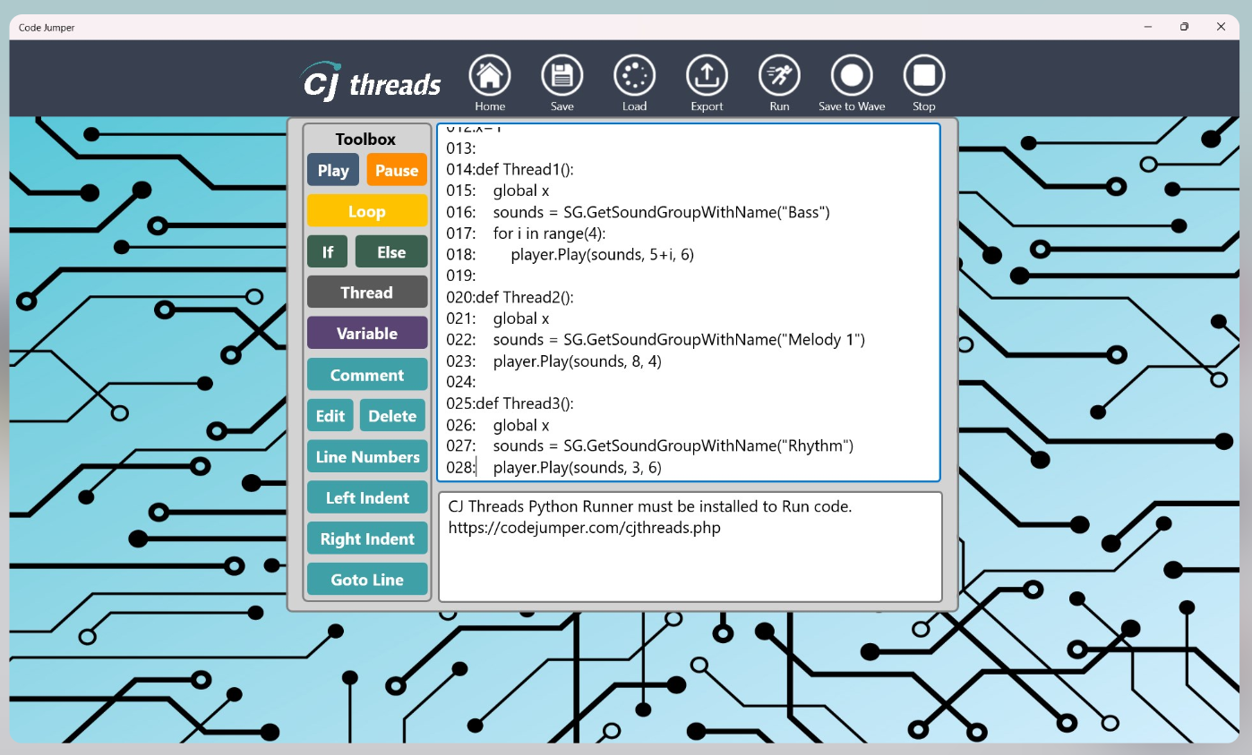
CJ Threads
August 26th, 2025
3-4pm EST
Notes:
Speaker: Katrina
Hello and welcome to: Code Jumper: Weaving the Way from Blocks to Python in CJ Threads
Today you will be introduced to CJ Threads — the new Code Jumper module designed to help students transition from accessible block-based coding to Python, all within the familiar context of Code Jumper.
This session will guide educators through the powerful features of CJ Threads that make learning Python concepts easier to grasp, more inclusive, and highly approachable. Educators and parents will discover how to access the update, what’s included, and where to find helpful resources to learn and explore CJ Threads.

Slide 2
Agenda
Welcome & Overview (5 min) (Katrina) 3:00-3:05pm EST
Access & Platforms (4 min) (Michael) 3:05-3:09pm EST
Installation & Setup (5 min) (Michael) 3:09-3:14pm EST
Navigating CJ Threads (30 min) (Liam) 3:14-3:44pm EST
Q&A Session (10 min) (All) 3:44-3:54pm EST
Final Remarks (6 min) (Dot 6) 3:54-4:00pm EST
Notes:
Speaker: Katrina
Our agenda for today includes the following...

Slide 3
Welcome & Overview (Katrina) 3:00-3:05
Ground Rules - Please post questions in the chat; we’ll address them at the end.
Code Jumper - Code Jumper is an accessible, hands-on coding tool originally designed for students who are blind or visually impaired. It uses physical pods that can be connected and programmed to create sequences of sounds, music, and stories, helping learners explore core coding concepts in a tactile and engaging way.
Notes:
Speaker: Katrina
We have one ground rule for today...

Slide 4
Introduction to CJ Threads (Katrina)
Start coding like a professional with CJ Threads, Code Jumper’s bridge to Python code. CJ Threads is a new feature that adds the ability to translate block code into a real coding language and dive into the fundamentals of Python all in the familiar Code Jumper environment. Level up your coding skills today with CJ Threads!
Resources - https://codejumper.com/cjthreads.php
Notes:
Speaker: Katrina

Slide 5
Price Drop as of 2/2/25 (Katrina)
Previous Quota Price: $769.00
Previous Non-Quota Price: $999.00
Quota Price (as of 2/2/25): $399
Non-Quota Price (as of 2/2/25): $534
Notes:
Speaker: Katrina

Slide 6
Access & Platforms (Michael) 3:05-3:09
How to access CJ Threads:
    Microsoft Store
    APH shop website
    Code Jumper website
Notes:
Speaker: Michael
Title for August 26th webinar: Code Jumper: Weaving the Way from Blocks to Python in CJ Threads
Summary: Join the American Printing House for the Blind for a webinar introducing CJ Threads — the new Code Jumper module designed to help students transition from accessible block-based coding to Python, all within the familiar context of Code Jumper. This session will guide educators through the powerful features of CJ Threads that make learning Python concepts easier to grasp, more inclusive, and highly approachable. Educators and parents will discover how to access the update, what’s included, and where to find helpful resources to learn and explore CJ Threads.
Three areas for obtaining content and downloading the app update are listed on this slide.

Slide 7
Installation & Setup (Michael) 3:09-3:14
Steps for Installing CJ Threads
Getting Started Guide - Overview of installation (available in HTML and Word versions)
Notes:
Speaker: Katrina

Slide 8
Navigating CJ Threads (Liam) 3:14-3:44
Walkthrough of the On-Screen Interface
Hotkeys Navigation Demo
Definitions of Interface Elements
Basic Build
Notes:
Speaker: Katrina

Slide 9
Q&A Session (All) 3:44-3:54
Open Discussion / Participant Questions – Addressed at this time
Notes:
Speaker: Katrina

Slide 10
Wrap-Up (Dot 6) 3:54-4:00
Webinar Recording – Will be posted to YouTube
Post-Survey – Check your email a few weeks after the webinar
Notes:
Speaker: Katrina

