Slide 1
Digitize your Braille writer: introducing paige connect
Digitize Your Braille Writer: Introducing Paige Connect

Slide 2
Ground Rules and Housekeeping
Please type your questions in the Chat ​​
No ACVREP credit for Partner Showcase​
Closed Captioning is Available

Slide 3
Poll Question
How familiar are you with Paige Connect?
Never met- I need introductions
I’ve waved from across the classroom once
It is on it’s way, waiting at the mailbox
We’re two peas in a pod

Slide 4


APH Staff
Sara Welch
Product Manager Educational Product Innovation
Melisa Matthews
Product Manager Braille Technology

Slide 5

Paige Braille
Greg Hargraves
Founder

Slide 6
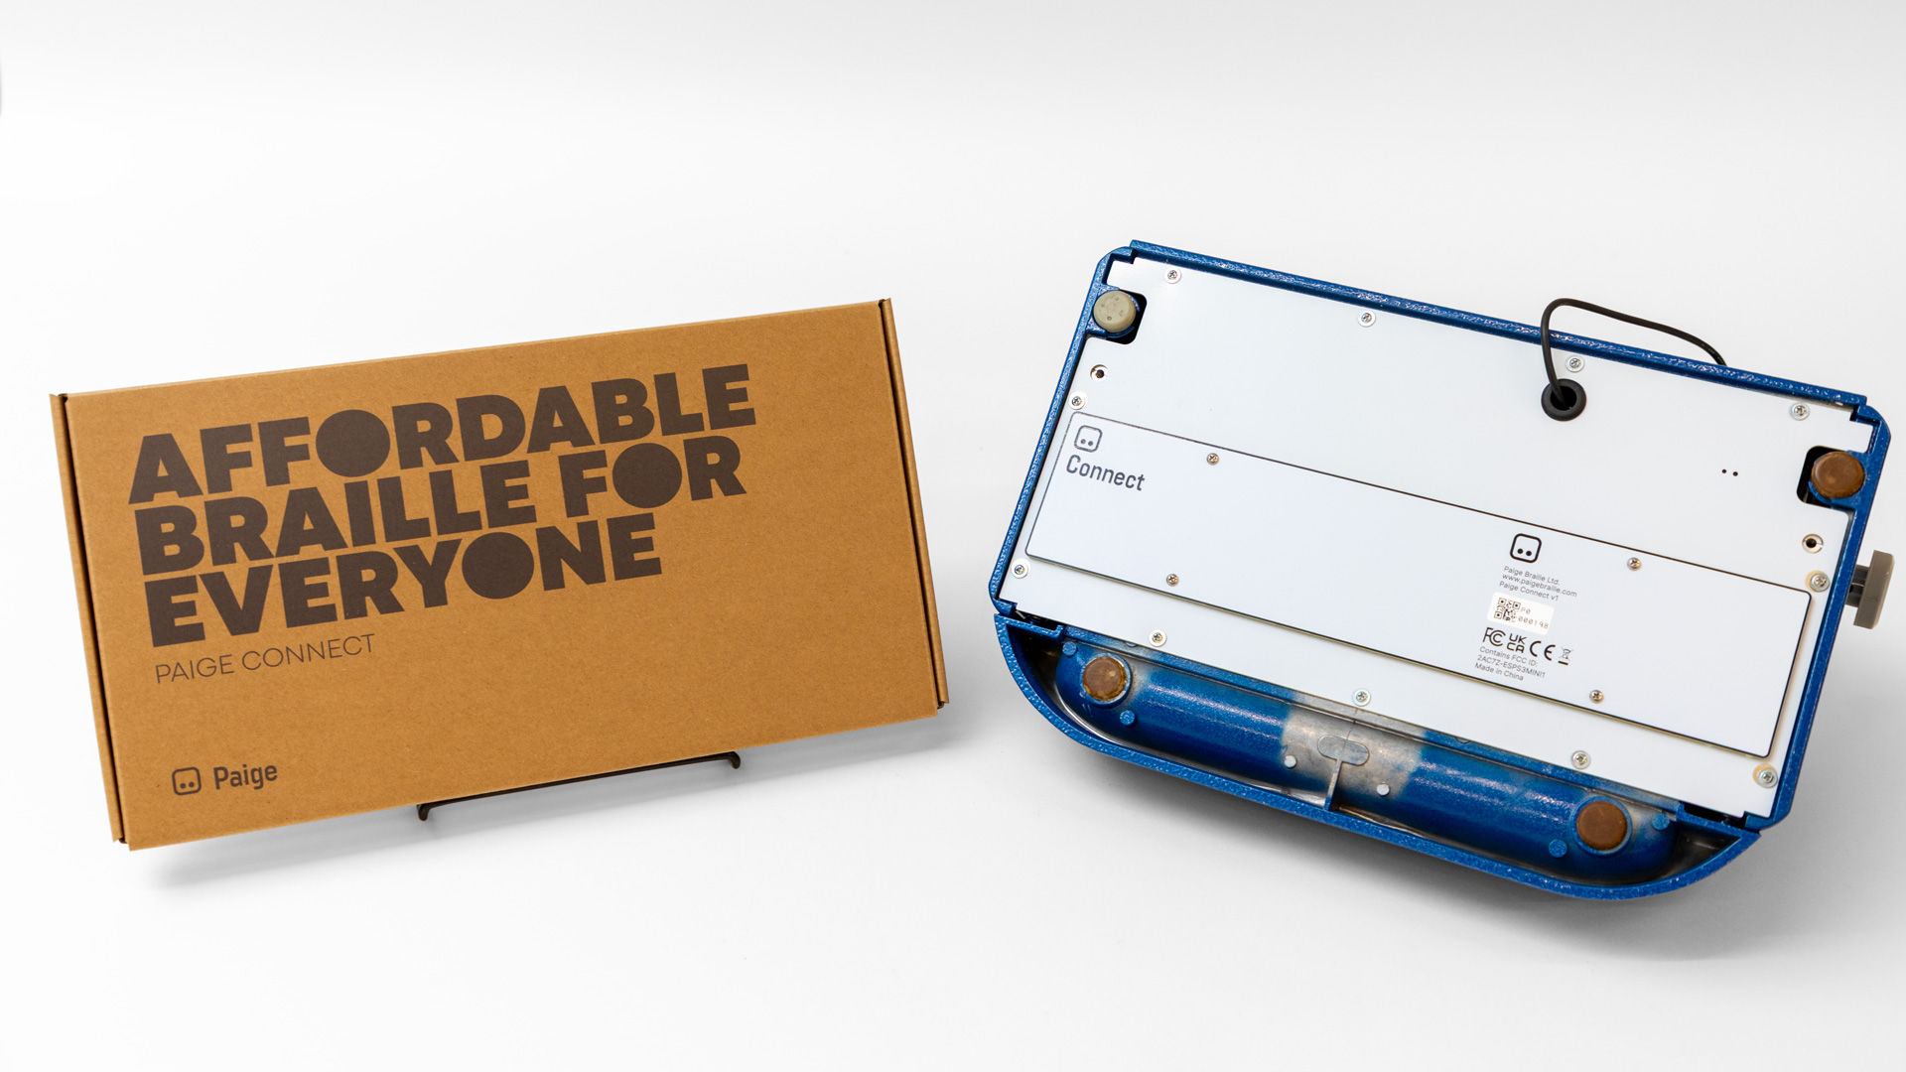
Paige Connect
Basic Information
Cost $339
Quota Eligible

Slide 7
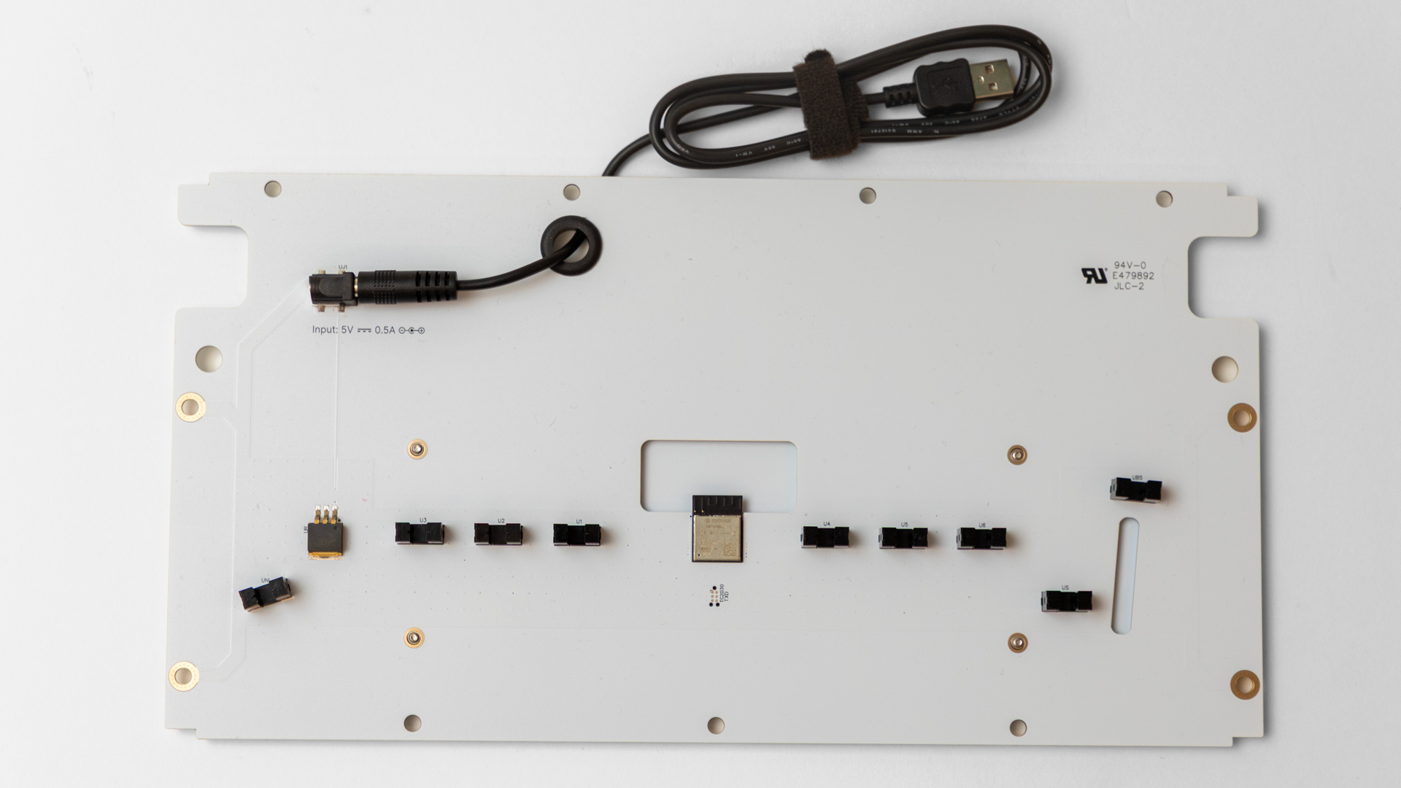
Paige Connect
The Guts
9 U-Shaped black optical sensors
USB-A power cord
Back of board round hole for power cord
Replaces the bottom or a traditional Braille Writer
Board is durable
Connects via Bluetooth

Slide 8
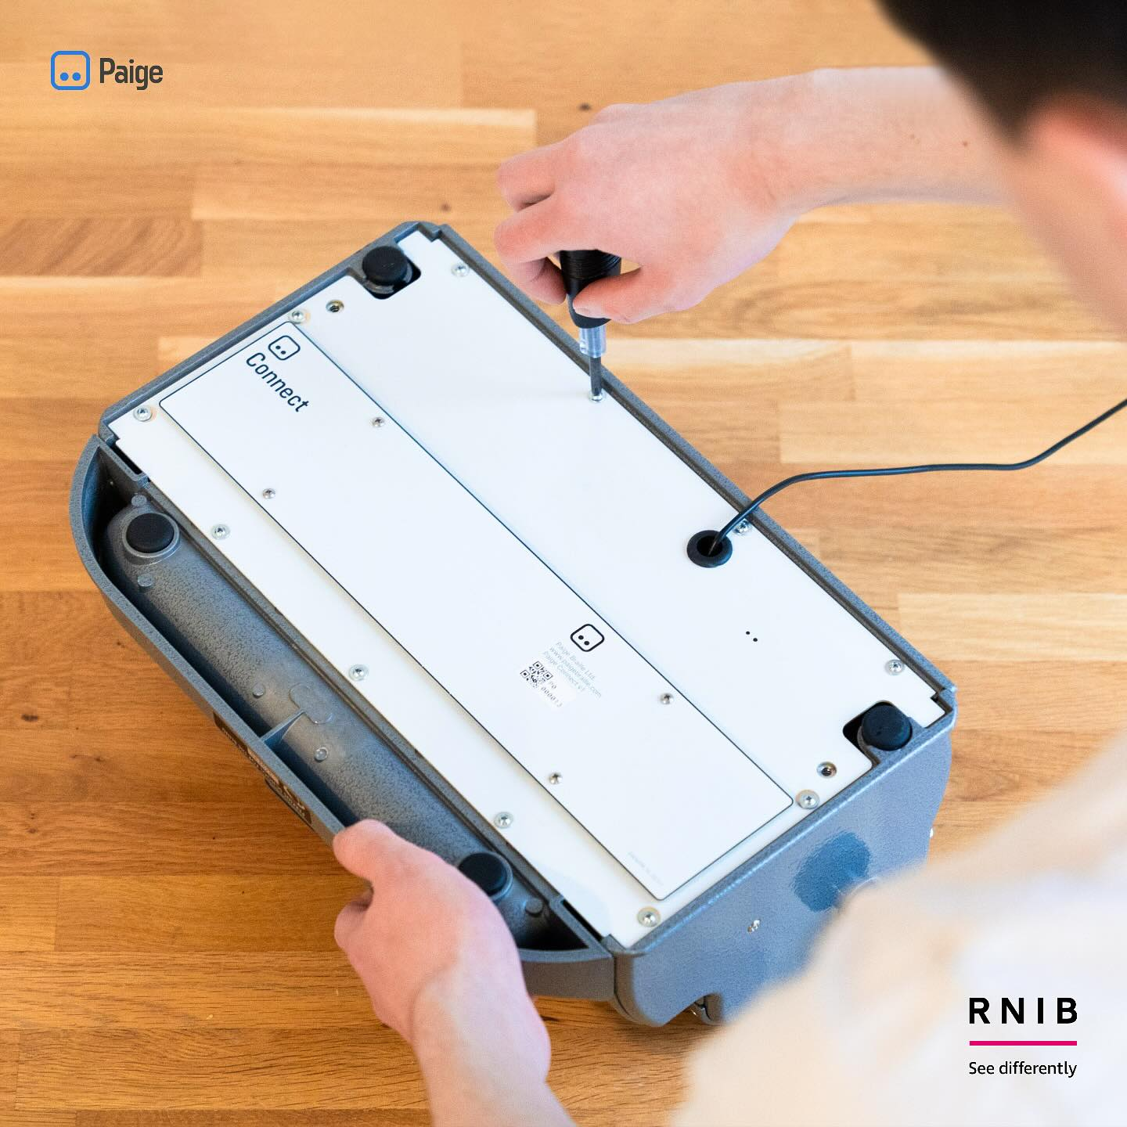
Paige Connect
Connecting you Paige Connect to a device or laptop.

Slide 9
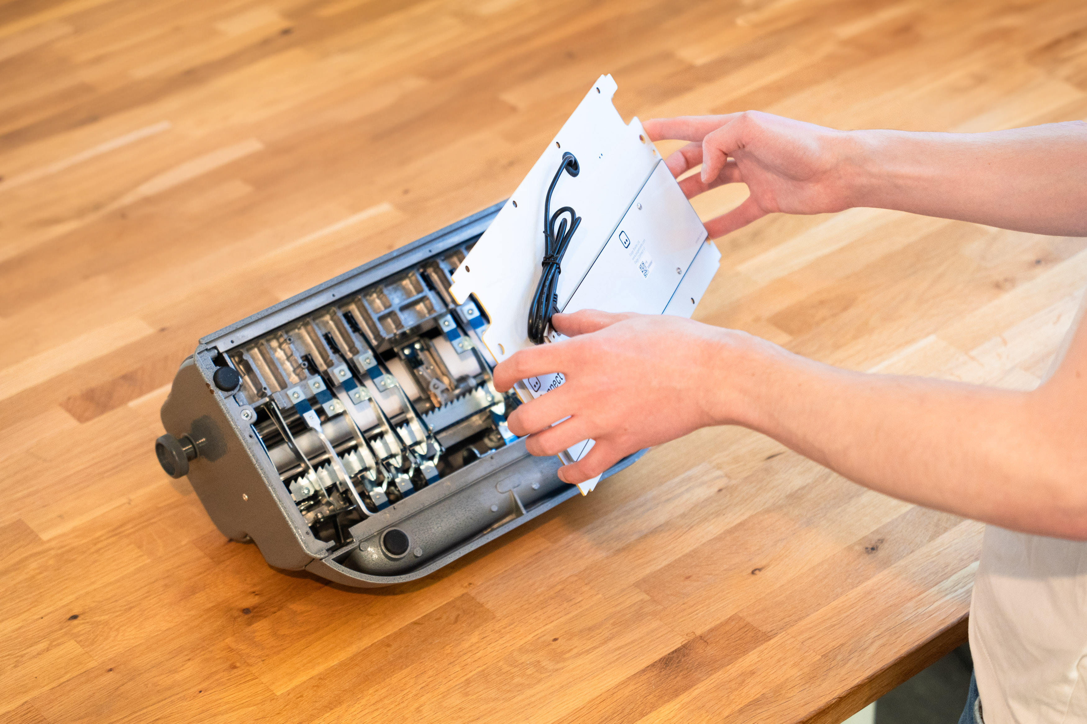
Paige Braille Website
The software and website are available to you and your learner.

Slide 10
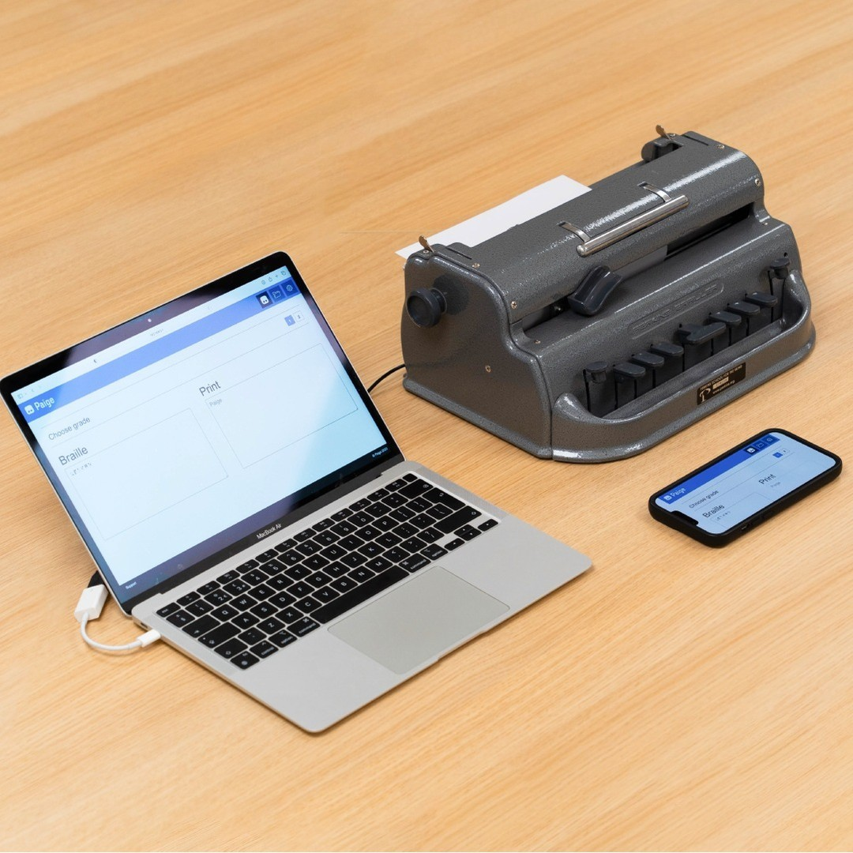
Paige Braille Website
From Low Tech to Today’s Learner Paige Braille in Action
Learn
Translate
Homework

Slide 11
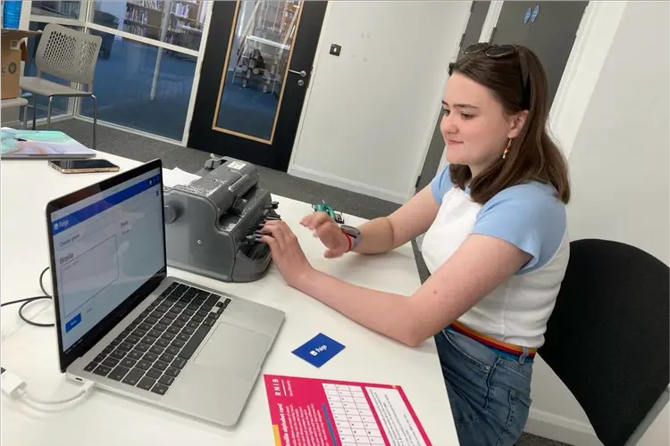
Paige Braille
Impact for you learner
School
Home
Vocational Rehabilitation

Slide 12
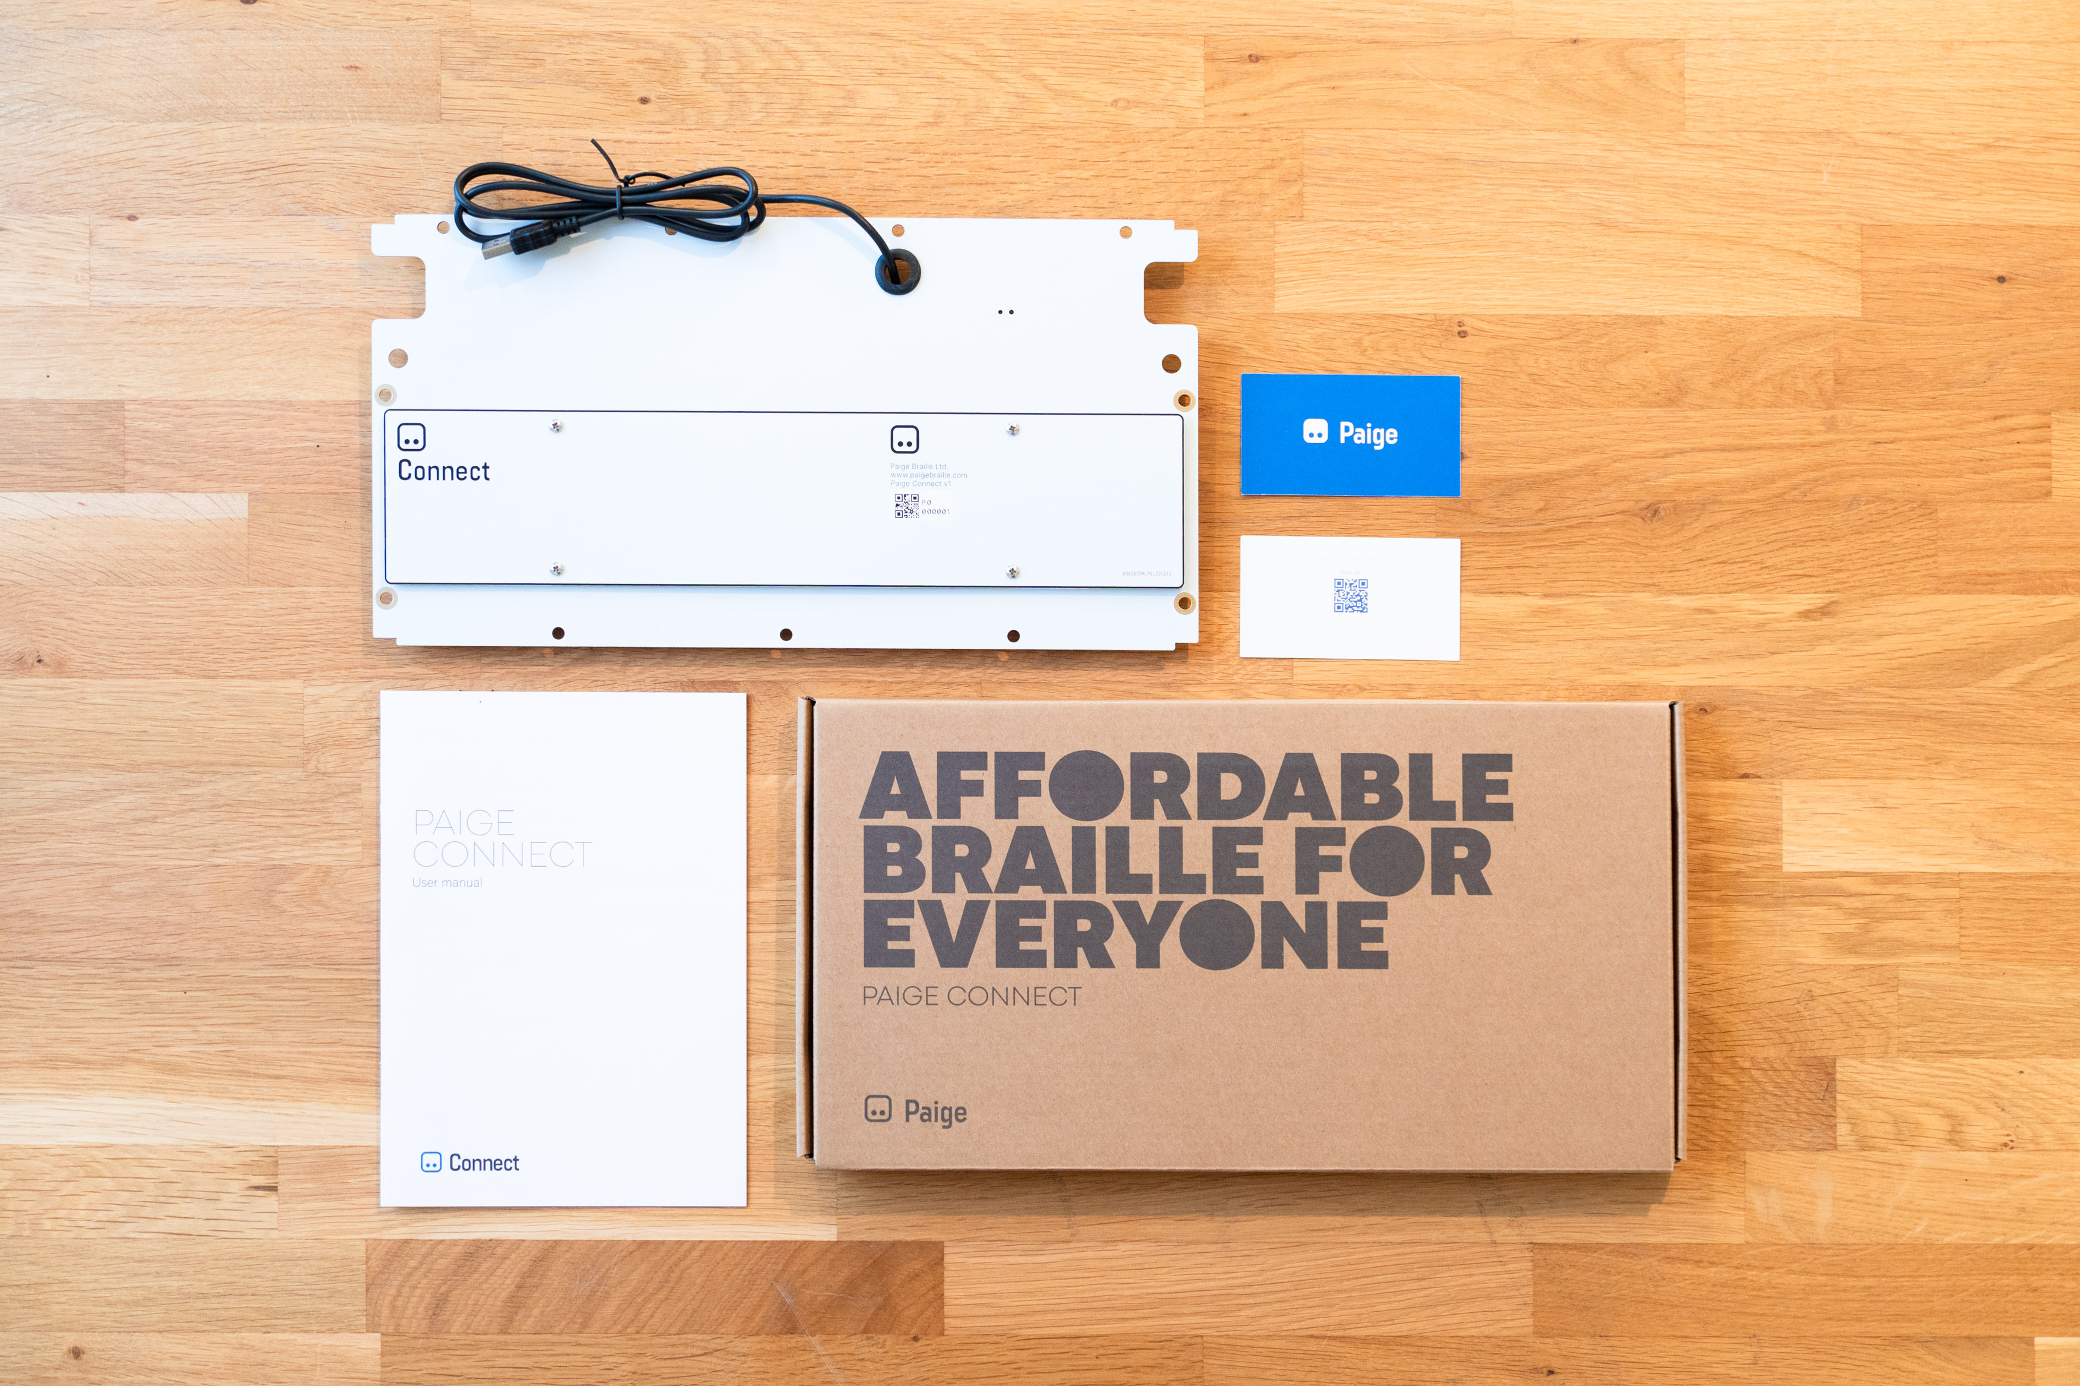
Paige Connect
Basic Information
Cost $339
Catalog Number:1-08570-00
Website: APH.org

Slide 13
Poll Question
After today’s session, what’s the first thing you’re most likely to do?
Brag to a colleague or family member about a cool new tool you just learned about.
Go down the rabbit hole of Paige Braille website (goodbye, free time)
Bust out some lesson plans and figure out where Paige Connect fits in.
Take a snack break and let it all sink in…action can wait (just a little while)

Slide 14
Thank you!
Questions?

